Slide 1

SmartContracts in HyperLedger Fabric in GoLang

Slide 2
Based on
https://github.com/hyperledger/fabric-samples
Uses docker to create a network with two peers on two different organizations and an orderer
./network.sh up starts the declared docker services
./network.sh createChannel -c torbennakamoto Can then be used to create a channel

Slide 3

HyperLedger Sample contains a demo application that in theory can be run in different languages
– in practice, not so much
./network.sh deployCC -c torbennakamoto -ccn basic -ccp ../asset-transfer-basic/chaincode-typescript -ccl typescript
peer chaincode invoke -o localhost:7050 --ordererTLSHostnameOverride orderer.example.com –tls ... -c '{"function":"InitLedger","Args":[]}'
Does not work

Slide 4
HyperLedger Sample contains a demo application that in theory can be run in different languages
– in practice, not so much
./network.sh deployCC -c torbennakamoto -ccn basic -ccp ../asset-transfer-basic/chaincode-typescript -ccl typescript
peer chaincode invoke -o localhost:7050 --ordererTLSHostnameOverride orderer.example.com –tls ... -c '{"function":"InitLedger","Args":[]}'
Does not work

Slide 5

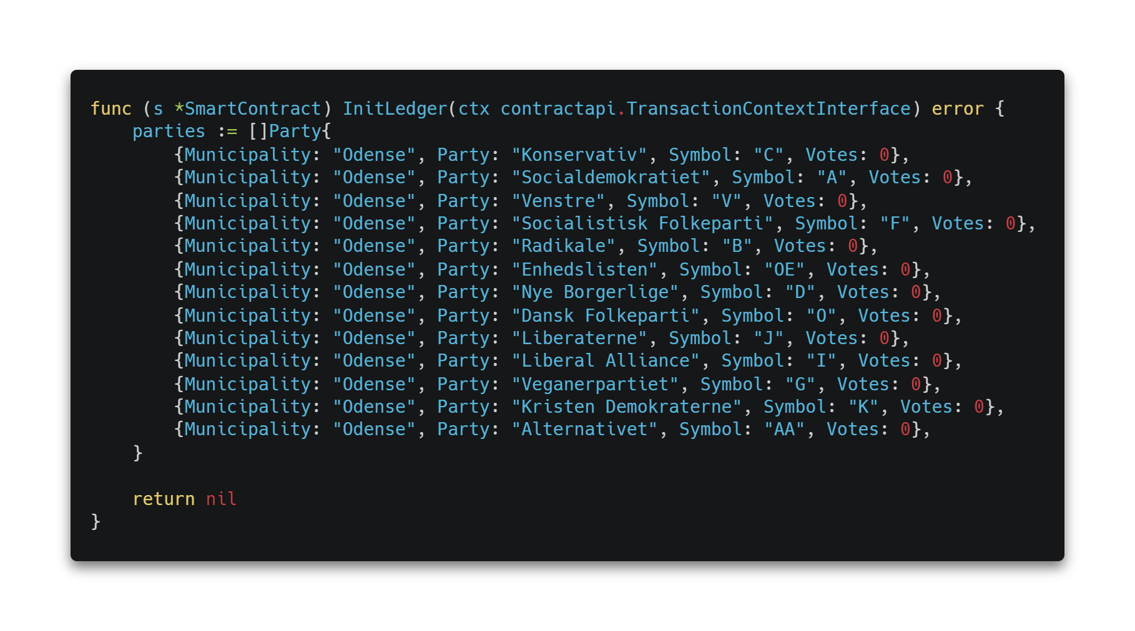
The GoLang Way ☹
(Why nil and not null?)

Slide 6

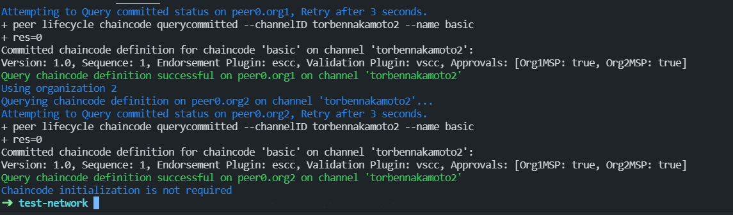
The GoLang Way ☹
Flawlessly deployed to the blockchain and approved by both peers

Slide 7
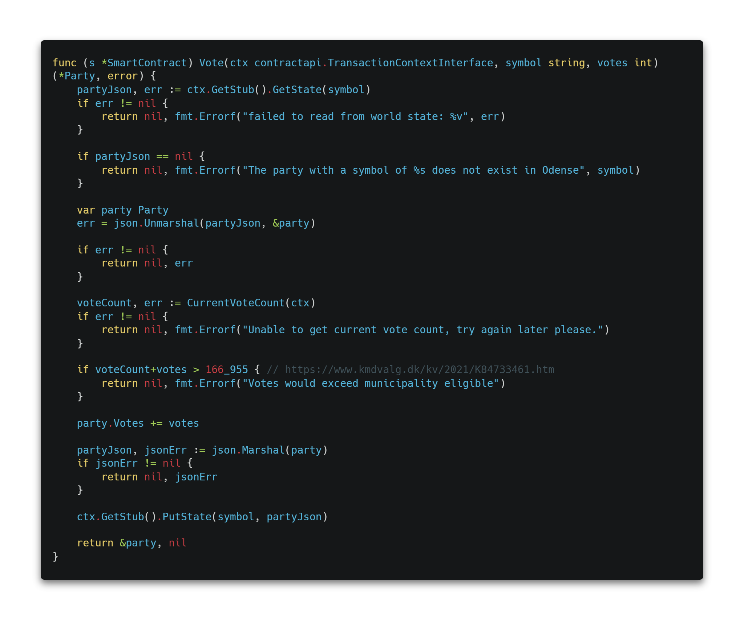
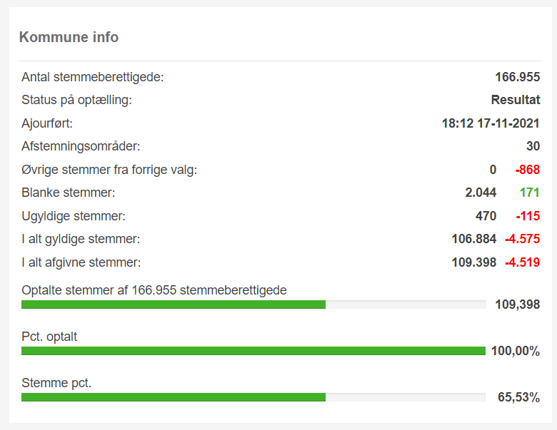
Vote function
Tediously many checks ☹, but ends up working regardless
Caps votes to the maximal amount of eligible people

Slide 8

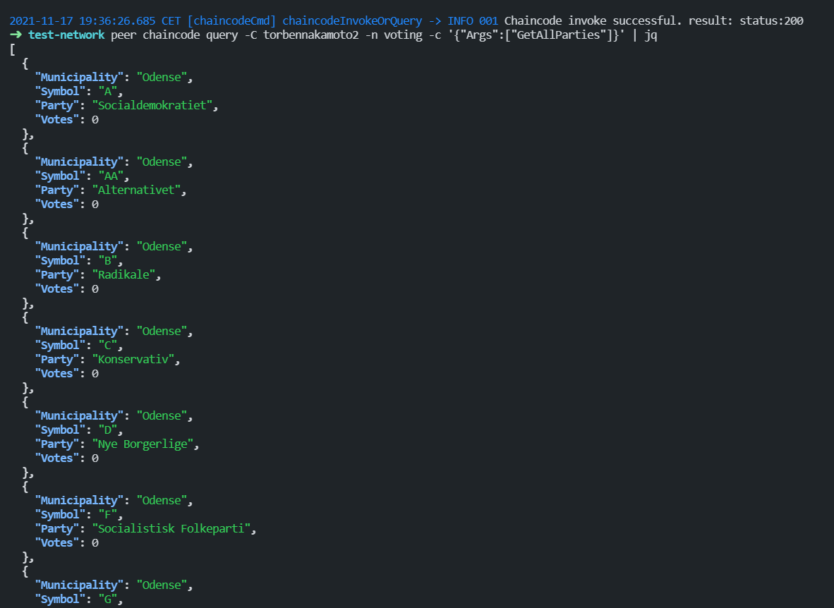
Querying the ledger

Slide 9

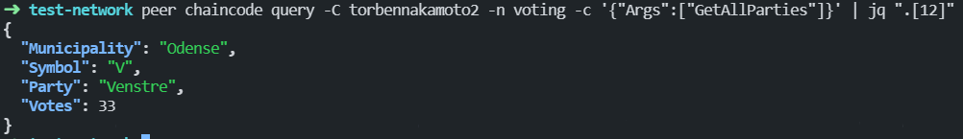
Voting for a party

Slide 10

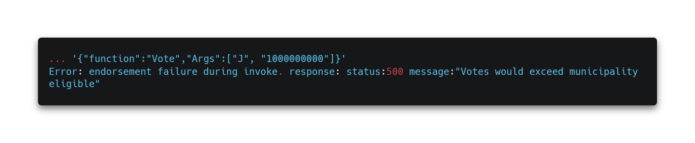
No Obvious Cheating Allowed

